Slide 1
The Early Intervention Foundation
SITRA June 2019

Slide 2
Who we are

Slide 3
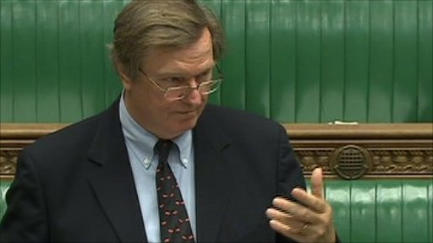
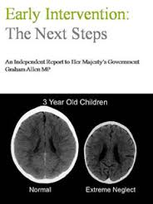
Starting the journey in 2011
Notes:
Journey began with unusual partnership between Graham and IDS – different sides of the political spectrum – both with a passion and interest in EI
Graham, founder chair of EIF – Coalition govt to report to the PM
His ground-breaking report – drawing on lots of existing knowledge
Growing research on case for early intervention drawing on research from – psychology, economics, neuroscience and social research.
Strong evidence for a number of specific programmes implemented internationally esp. in the US - Family Nurse Partnership introduced in UK
Lack of evidence for programmes in UK context
The Early Intervention Foundation created in 2013 with all-party support

Slide 4
What Works Centres – a culture of evidence

Slide 5
2018: A new five year strategy for EIF
Our vision is that all children are able to achieve their full potential
Our mission is to ensure that effective early intervention is available and is used to improve the lives of children and young people at risk of poor outcomes.
When we talk about early intervention we mean identifying and providing effective early support to children and young people who are at risk of poor outcomes.
We define effective as showing evidence of improving outcomes for children and young people.

Slide 6
Making the case
Generating evidence
Using evidence to change policy and practice
Communications
Funding
Working in partnership
Measuring our impact

Slide 7
How does early intervention work?
Studies show that early intervention is likely to have its greatest impact when targeting seven key outcomes, starting with the four primary domains of child development
Cognitive
Obesity & Physical Health
Physical
School achievement & entry into the workforce
Mental health & wellbeing
Social &
Emotional
Behavioral
Crime, violence & antisocial behaviour

Slide 8
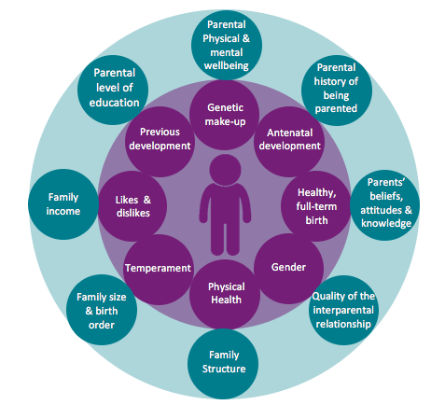
Childhood risk and disadvantage
We have a good understanding of the risk factors that can threaten children’s development
With skilled assessment, children and families who would benefit from extra support can be identified

Slide 9
Our work

Slide 10
Findings: The fiscal cost of ‘late intervention’
“early intervention has the potential to reduce costs to the public sector before issues become entrenched and more expensive to deal with”
Nearly £17 billion is spent each year by local and national agencies on acute and statutory services for children, young people and families in England and Wales. This is equivalent to £287 per person.

Slide 11
UK Late Spend: Northern Ireland Example
Comparisons between English Local Authorities and Northern Irish Regions
English Local Authorities and Northern Ireland Local Government Districts ranked from highest to lowest late intervention spend per head

Slide 12
UK Late Spend: Northern Ireland Example
Variation in drivers over time
Child protection and safeguarding
Unemployment
Health
Crime

Slide 13
‘Foundations for Life’
“Foundations for Life: What Works to Support Parent Child Interaction in the Early Years” is a groundbreaking assessment by the Early Intervention Foundation of 75 early intervention programmes aimed at improving child outcomes through positive parent child interactions in the early years.
Notes:
Represents the next stage in the Allen Review
Creating foundations for a UK evidence base for Early Intervention
Use EIF’s own ratings, approach, cost scale
Drawing on expertise of partners
Focus on relationships – parent and child and parent and parent

Slide 14
Key messages
The evidence and cost of 75 interventions were assessed. 17 interventions were identified as evidence-based.
There is already good choice of effective addressing children’s noncompliant behaviour. There is good evidence to suggest that if offered at age 3 or later, they may reduce the likelihood of persistent non-compliant behaviour. These programme are low cost.
There is less choice of programmes addressing children’s attachment security. These programmes are likely to be high cost.
There is less choice of evidence-based interventions that support children’s early learning through parent child interaction. These programmes should be offered in addition to centre-based programmes and are likely to be medium to high cost.
Attachment
Behaviour
Cognitive development

Slide 15
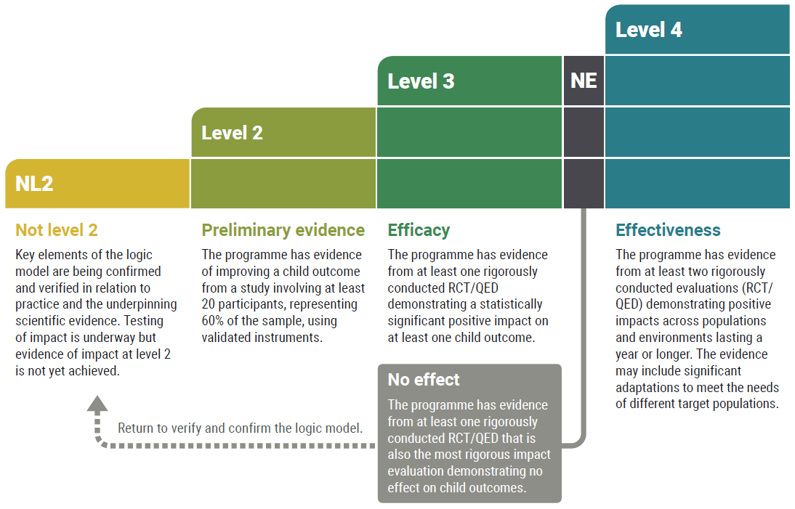
Notes:
We have a set of evidence standards which we use to classify interventions and work out which ones have been shown to improve one or more child outcomes.
L3 & 4 is what we mean by ‘effective’
L3 = evidence from at least one rigorous study demonstrating a statistically significant +ve impact on at least one chid outcome.
L4 is highest = evidence from a least 2 high quality evaluations which demonstrate positive impacts across populations and environments
Complex work –won’t bore you with the details, but we have panel of experts assessing the evidence against 34 criteria in order to rate interventions according to strength of evidence
Also want to make the point that of course evidence is not the only consideration in deciding what to commission. Also need to consider cost, fit with your local context, workforce etc
Evidence will only tell you what has worked with a certain population or in a certain context. Won’t tell you if it will work for you. And so ratings are never a replacement for skilled judgement by local decision makers.
Not saying don’t deliver things which have not been found to improve child outcome. BUT am saying make sure if you have interventions which fall into this category that you must evaluate or monitor them to be sure they are delivering the improvements that you are aiming for.
But key message is that evidence matters…

Slide 16
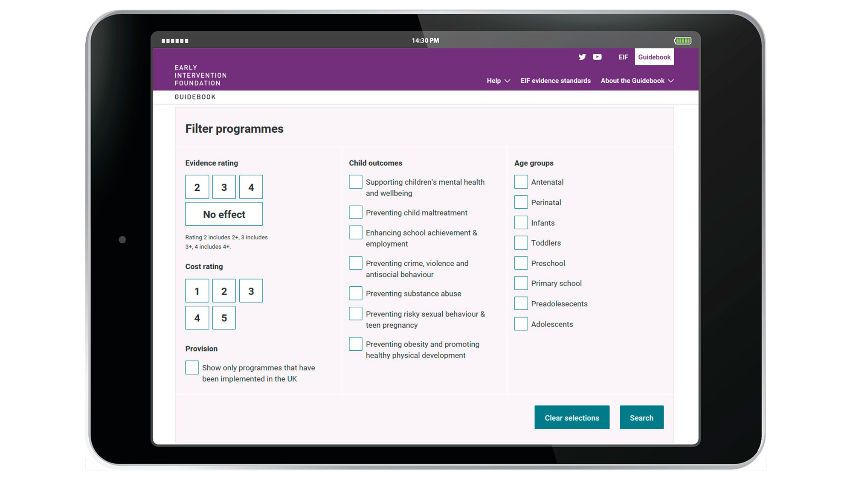
Notes:
In terms of how the Guidebook is used, the page you can see on the slide is the gateway or entry point to the Guidebook content.
Programmes are fully searchable by many of the features just described – i.e. strength of evidence, cost, outcomes achieved, and characteristics of the target population.
We current have 101 programmes and expect this to increase by 10 or so over the next financial year.
--
These are slightly old numbers, but:
The GB receives over 20,000 visits a year, and almost 70,000 in total since it was launched in October 2014.
The Guidebook has a nationwide reach: less than 30% of UK-based Guidebook users are in London, and over the past year it’s had at least 50 visits from nearly 50 different UK locations. Since its launch, it has been accessed by local authorities or major public services in at least 85% of top-tier local government areas in England.
Around 30% of Guidebook users are outside the UK – predominantly from the US, Australia and Canada.

Slide 17
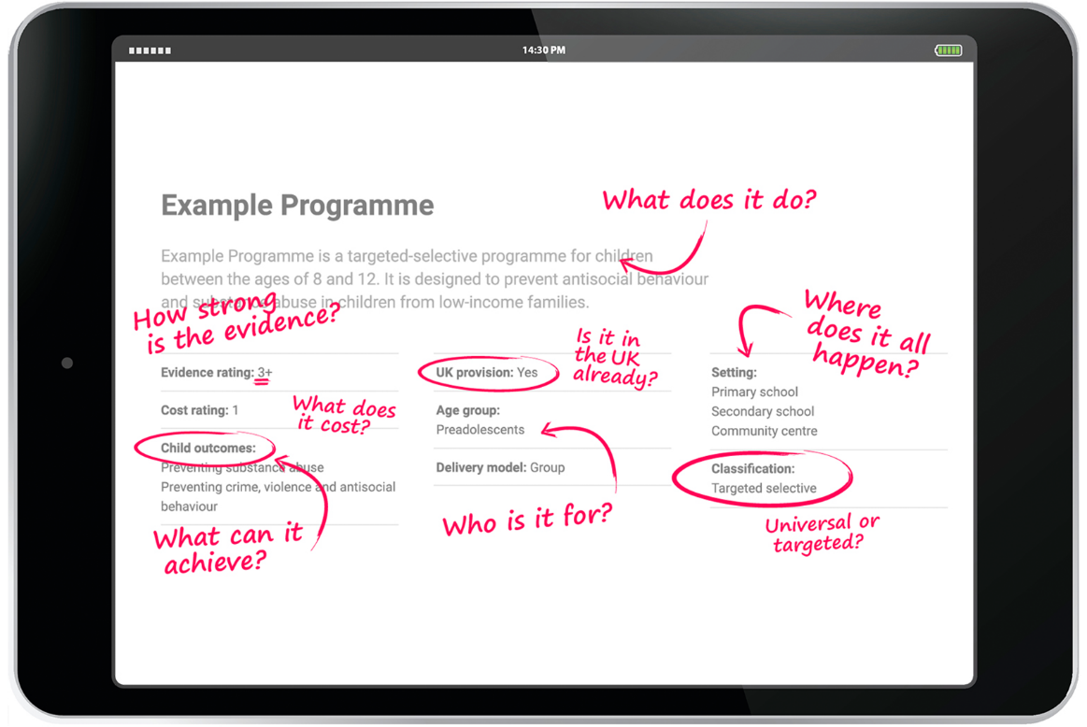

Slide 18
Early Years
The Early Years, covering conception to age five, are foundational in children’s lives. Our early years work spans everything from:
maternal health during pregnancy;
the impact of the early home learning environment; and,
the drivers of quality in pre-school education.

Slide 19
Social and Emotional Learning
The evidence on the long term associations between social and emotional skills in childhood and adult outcomes (mental health and wellbeing, labour marker, physical health and health
A review of evidence on the effectiveness of school and out-of-school interventions in the UK
The role of evidence based programmes in supporting children and young people at risk of gang involvement

Slide 20
Interparental Conflict
The influence of frequent, intense and poorly resolved couple on children’s development and what works to improve outcomes for children

Slide 21
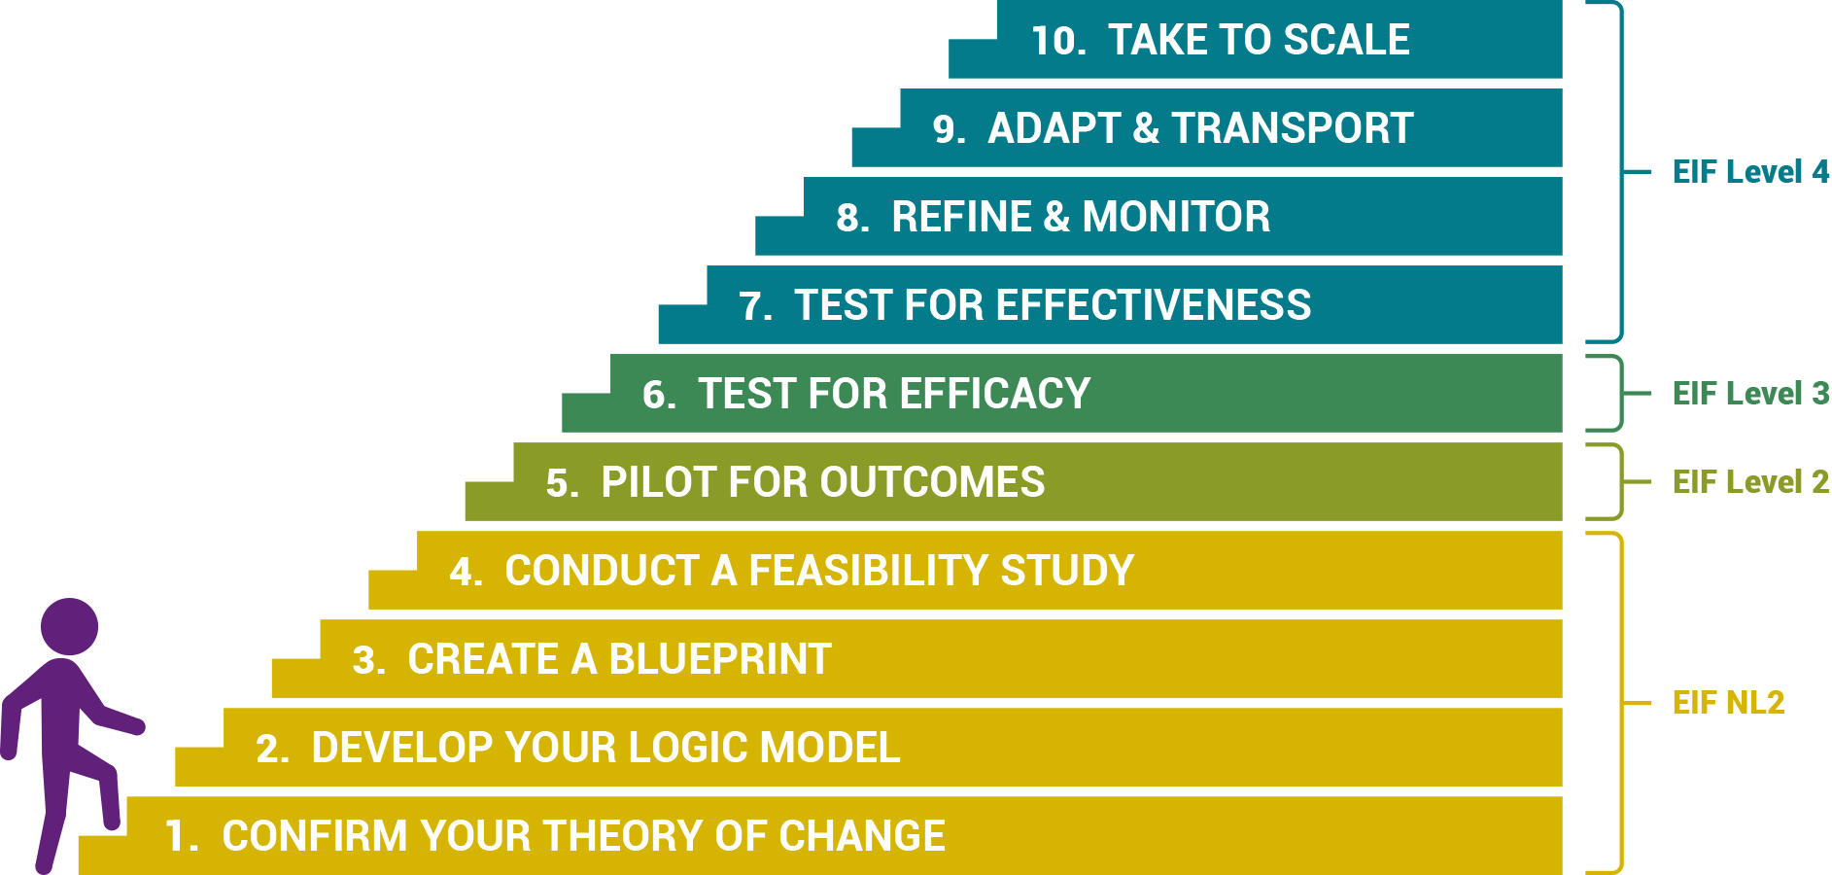
Improving evaluation
Supporting providers and developers to go on the evidence journey and understand if there services work to improve outcomes for children and families

Slide 22
Youth Endowment Fund?
Our Purpose: to prevent children and young people from getting caught up in crime and violence by making sure that those at most risk get the best possible support, as early as possible
Resources: £200m endowment from the Home Office to be spent over 10 years
Scope: focus on early intervention with young people aged 10-14 in England and Wales

Slide 23
How we have impact

Slide 24
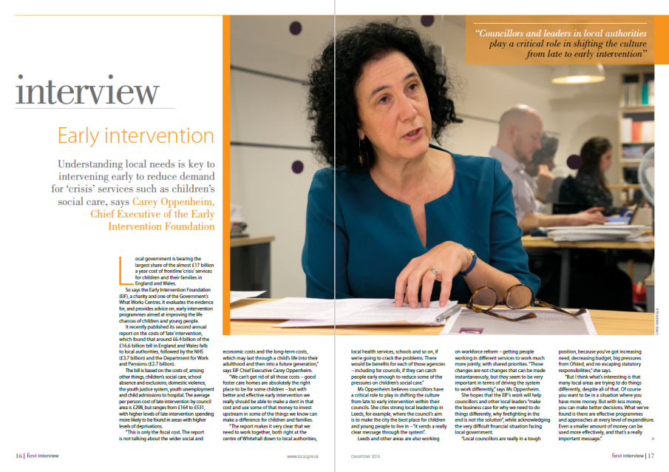
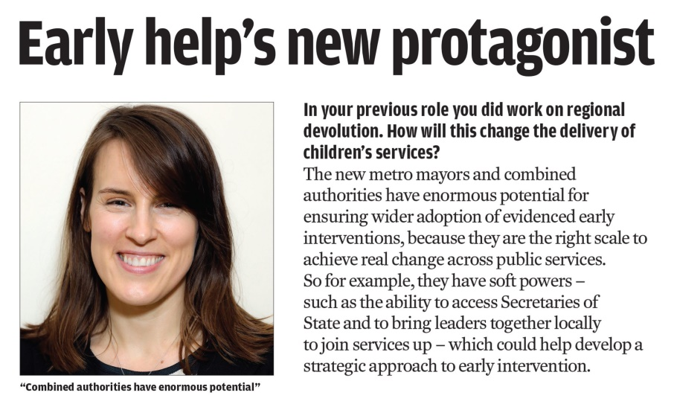
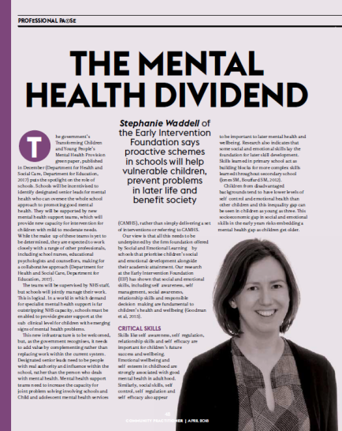
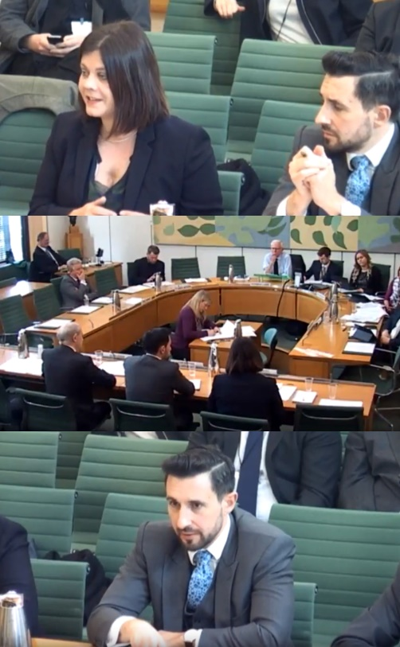
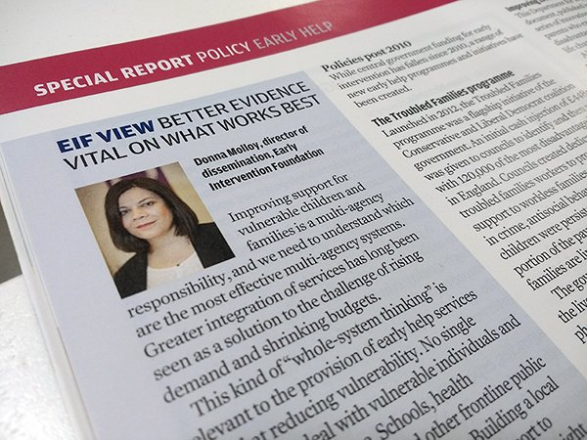
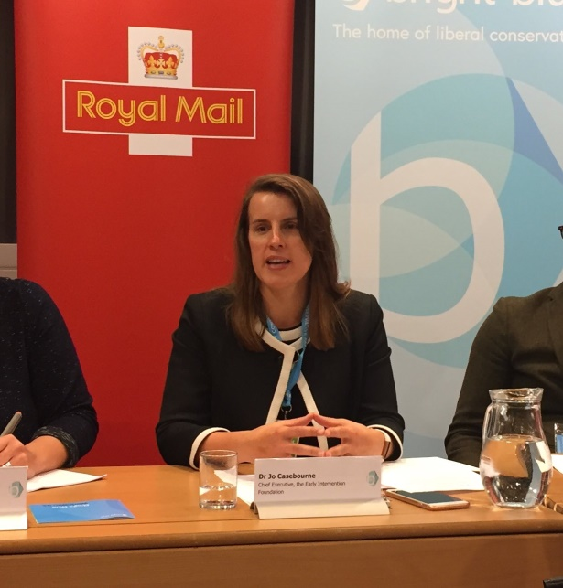
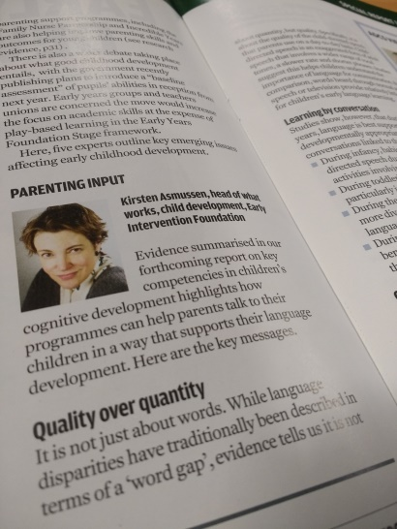

Slide 26
Overall Reflections
Having a foot in both the research and policy camps is critical
Embrace complexity and nuance
Aim to be a critical friend
Invest in depth, breadth and rigour to earn the right to be part of the conversation
Get off the fence

Slide 27
www.eif.org.uk
tom.mcbride@eif.org.uk
@Tom_EIF/ @TheEIFoundation

