Slide 1
WHAT WORKS
Launch
Ruth Doggett, DCYA
19th June 2019

Slide 3
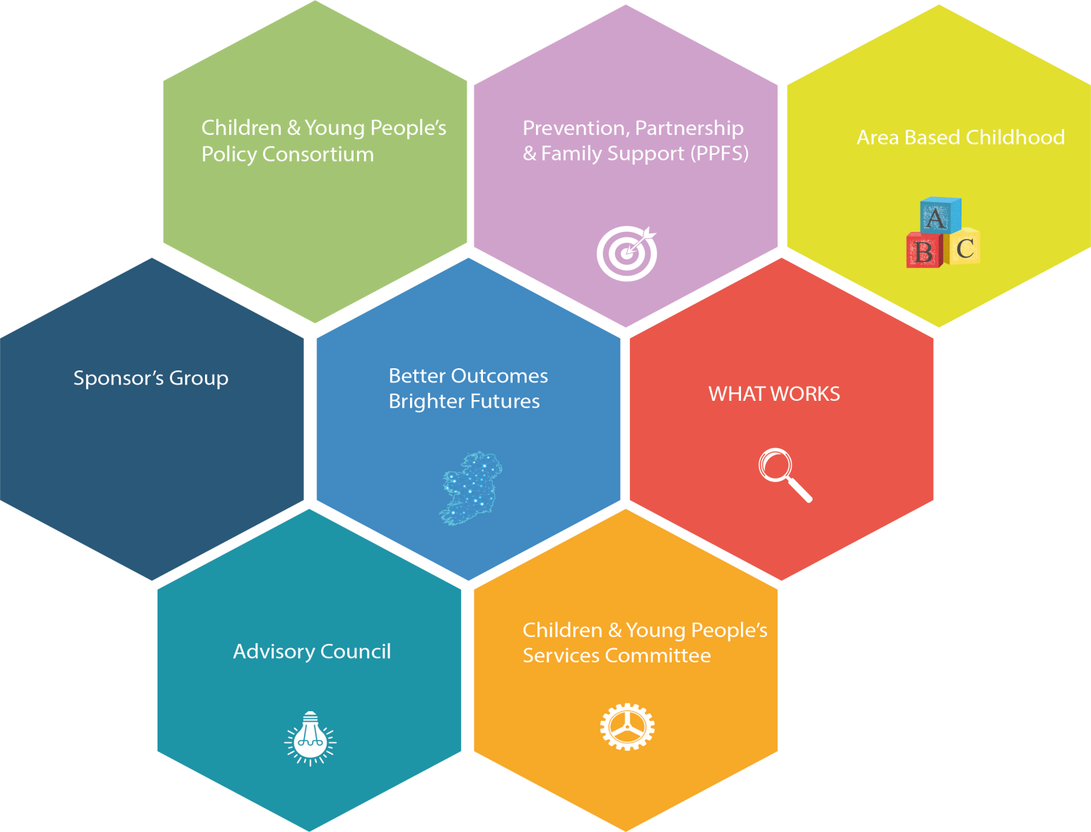
Better Outcomes, Brighter Futures Cross-Sectoral Priority: Prevention and Early Intervention

Slide 4
Embedding Prevention and Early Intervention into the System
Improved Outcomes for Children, Young People and their Families
1
Enhancing the Information Base (Data)
2
Enhancing the Evidence Base (Evidence)
3
Enhancing the Capacity of the workforce (Learning & Development)
4
Enhancing and Sustaining Quality (Delivery)

Slide 6
What is What Works About?
WHAT WORKS is about working together to ensure that Ireland is one of the best countries in the world for our children and young people to grow up.
WHAT WORKS is about bringing together, sharing, questioning and using all the evidence we have about what works to improve children and young people’s lives today so that they may have brighter tomorrows.
WHAT WORKS is about fostering persistent curiosity amongst those working to improve the lives of children and young people in Ireland.
WHAT WORKS is about supporting those working with and for children, young people and their families in doing the right things, in the right way and at the right time.
It’s good to share. Learn WHAT WORKS

Slide 7
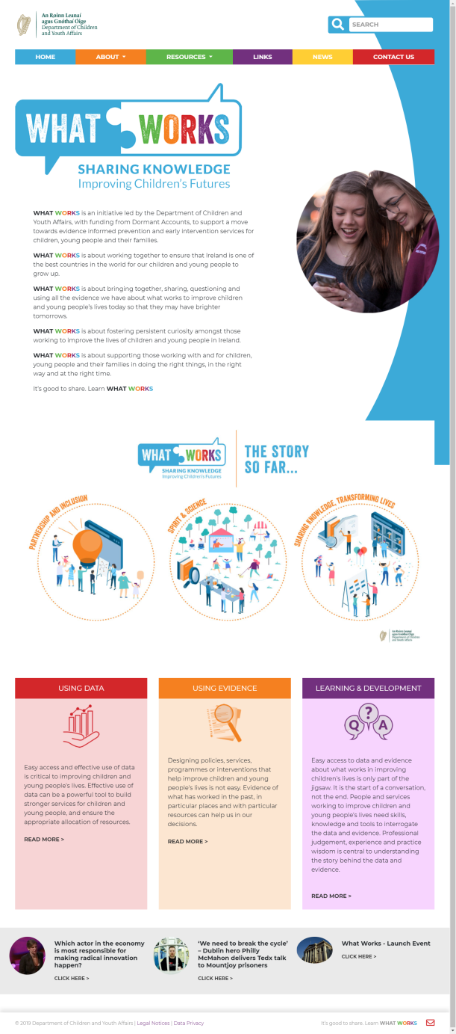
https://whatworks.gov.ie

Slide 8
Improving Access and use of Data
Outcomes for Children Data Hub
Department and Sector Wide Initiatives
Toolkits and Guides
Case Studies

Slide 9
Improving Access and use of Evidence
Evidence Matrix
Evidence Reviews
Emerging Research
Implementation and Improvement Science
Toolkits, Guides & Briefings

Slide 10
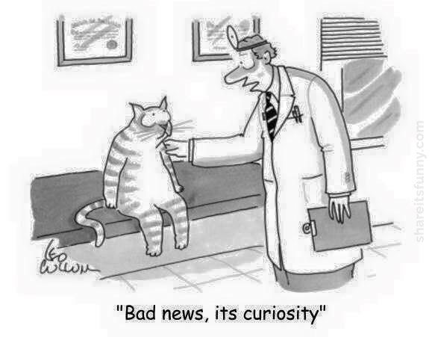
Supporting Curiosity
What Works Learning Framework 2019
Innovation Fund 2018
Network Support Fund 2018/2019
Executive Leadership Programmes
Action Learning Sets
Data Seminar - 19th September 2019
Using Evidence – 8 one day workshops 2019/2020
What Works Conference – Dublin Castle, 5th February 2020

Slide 11
Work with Us!
www.etenders.gov.ie
Reference: 152596-proj000000184-ssb029c

