Slide 1
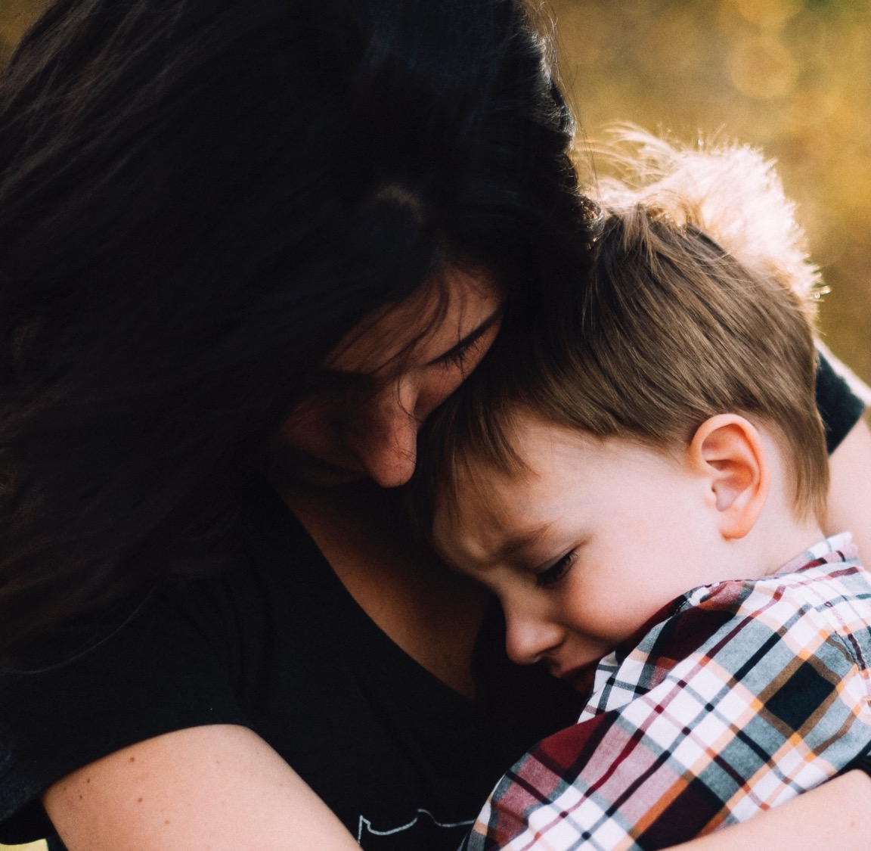
THE VALUE AND PURPOSE OF DIFFERENT RESEARCH DESIGNS FOR UNDERSTANDING WHAT WORKS

Slide 2
PLAN FOR TODAY
What is ‘what works’?
Different kinds of research and why we need them
Putting it all together: evidence hierarchies, evidence standards and evidence strength
Using ‘what works’ evidence
Notes:
Housekeeping
We have an hour and a half but might take less time than that
Don’t have a scheduled break but feel free to step away from the screen and leave it running if you need to
Do use the chat to participate – my colleague Steph is also on the call and will help with monitoring them

Slide 3
WARM UP
What do you think of when you hear the term ‘research’ in the context of children’s services?
What does ‘evidence-based’ mean to you?
Notes:
Open text poll / word cloud
-----------------------
In this webinar we'll be explaining why different kinds of research are needed to understand how interventions work, and why robust trials are needed to understand what works. We'll explore the advantages and limitations of different kinds of research evidence; the difference between evidence strength, evidence standards and evidence hierarchies; and why experimental evidence is typically prioritised for identifying ‘what works’.

Slide 4
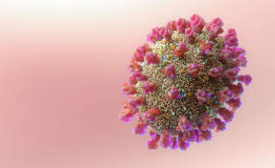
WHAT IS ‘WHAT WORKS’?
Notes:
Does anyone know what this is? Taking you back to 2020 and the start of the covid-19 pandemic.

Slide 5
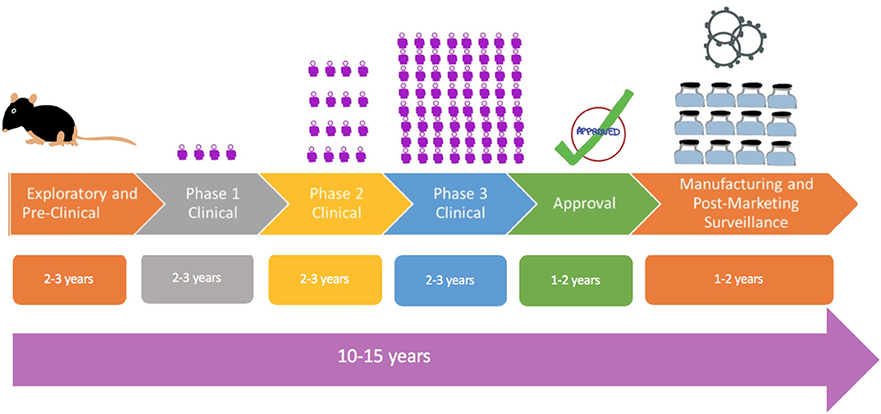
WHAT IS ‘WHAT WORKS’?
Notes:
During the pandemic we all became home experts in all sorts of things, including vaccine development. The medical trial model, which is used to develop vaccines and treatments, is well-established, and goes through a series of phases, starting with observational, exploratory and experimental pre-clinical work. There are then a series of clinical trials with increasingly large groups, and the vaccine is rolled out in and tested in more everyday settings.
Does anyone know how long this whole process takes typically?

Slide 6
WHAT IS ‘WHAT WORKS’?
Notes:
10-15 years.
But remarkably, in England it was just 8 months between the setting up of the Vaccine Taskforce and the NHS rollout.

Slide 7
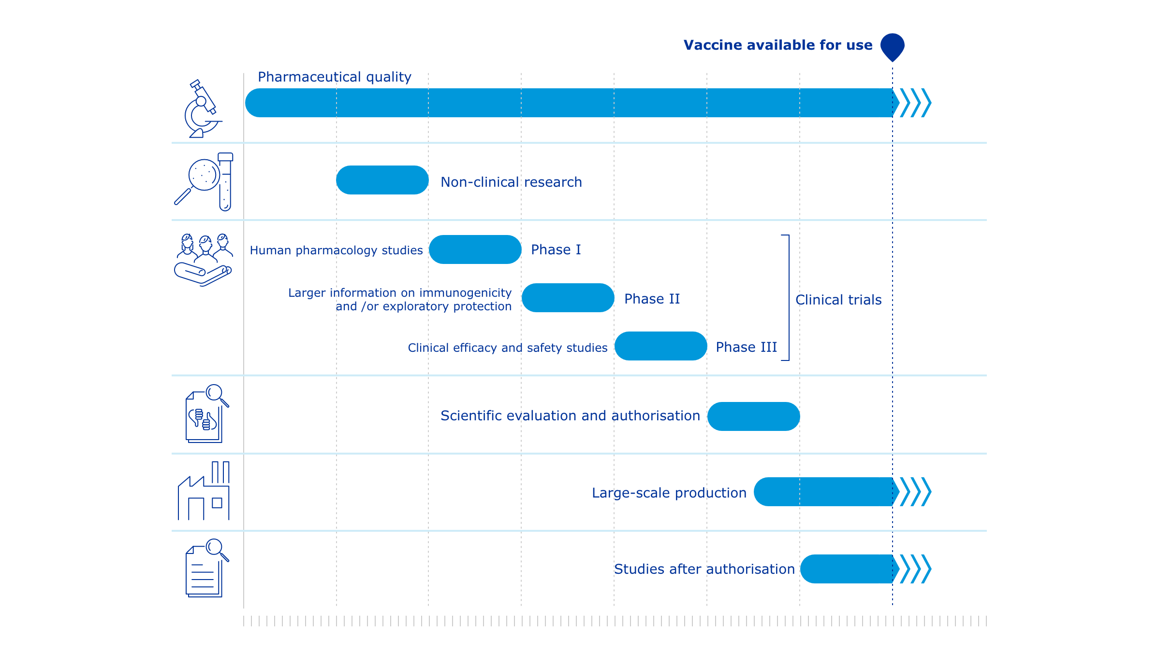
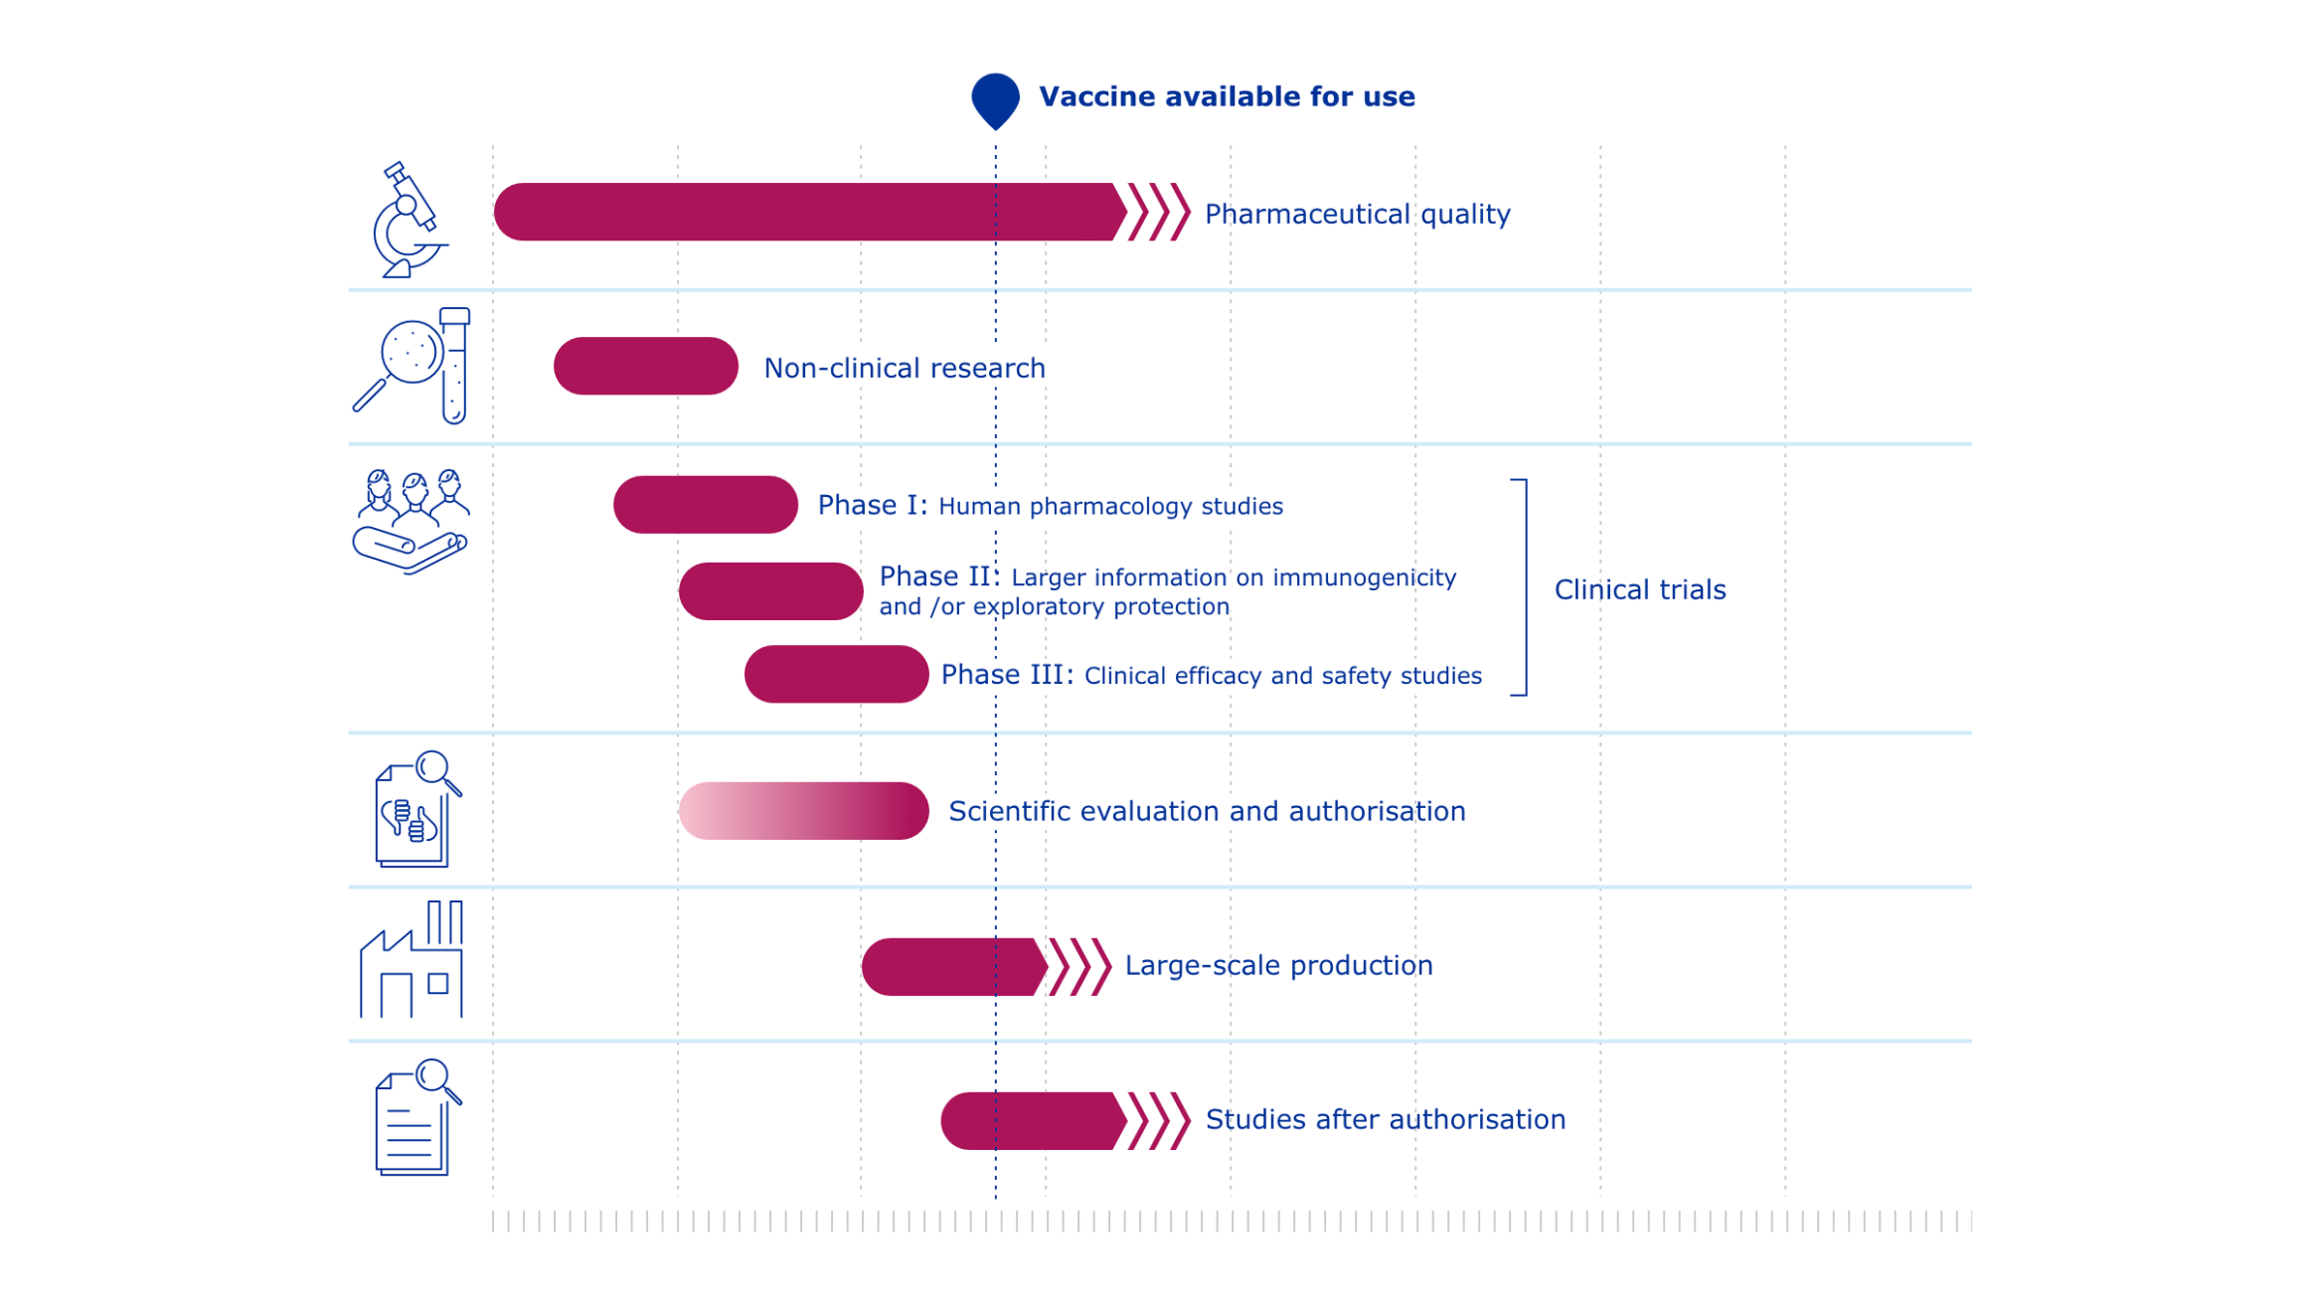
WHAT IS ‘WHAT WORKS’?
For more on covid vaccine development see: COVID-19 vaccines: development, evaluation, approval and monitoring | European Medicines Agency (EMA) (europa.eu)
Notes:
And if you’re interested, this is how they were able to do it: by building on a lot of existing knowledge, and condensing these steps, so they were no longer sequential, one after another, but in parallel.
And at the end of this pipeline, there is what we might call ‘what works’ evidence: the efficacy and effectiveness of the vaccine. This is based on large-scale randomised control trials, where people are randomly put into two groups, to receive the vaccine, in this case, or not, and their outcomes compared. How effective is the vaccine? How much does it reduce the risk of serious illness or death from covid?
Why do I start here? In early intervention and children’s social care, we often want to answer the same question: how effective is a particular parenting programme, therapy or way of working with families? How much will it reduce the risk of children going into care, for example? Or will it improve children’s wellbeing, or reduce parenting stress?
And we can use the same kind of evaluation pipeline, ultimately using Randomised Controlled Trials or other Quasi-Experimental designs, to find out which interventions are evidence-based.
However, unlike with the covid vaccine, we usually need to take substantial time to develop, test and improve interventions, and make sure they can be implemented effectively.
This evidence can then be used to inform policy making and service delivery – the What Works Network in the UK was set up to do just this.

Slide 8
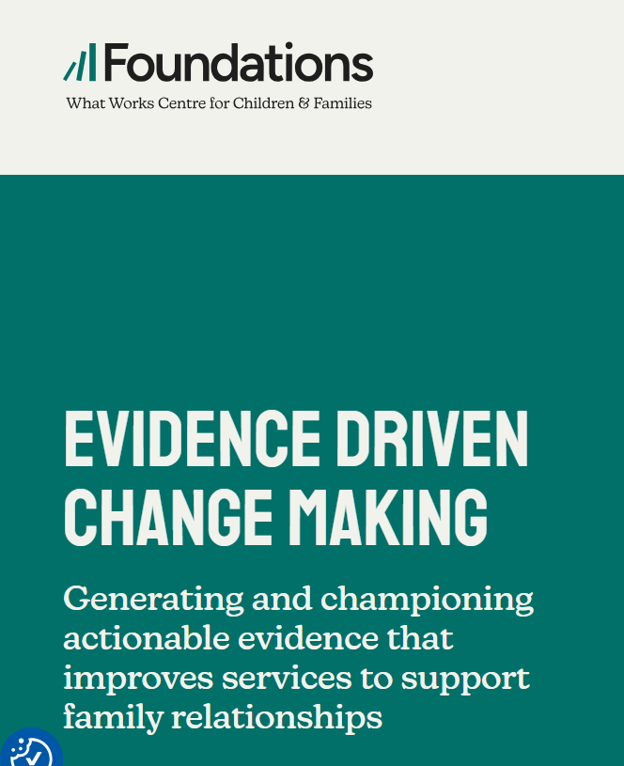
WHAT IS WHAT WORKS?
Benefit to people
Avoid harm
Efficient use of resources (don't waste on ineffective things)
Improve interventions and services (ongoing monitoring, fidelity, rapid cycle testing)
Effective interventions can scale up - evaluation pipeline
What Works Network - GOV.UK (www.gov.uk)
Notes:
Why do we want what works evidence?

Slide 9
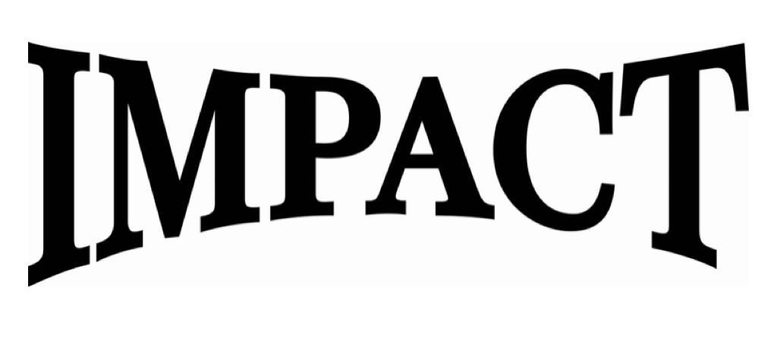
DIFFERENT KINDS OF RESEARCH
Notes:
If we go back to our vaccine pipeline, note that different kinds of research were needed: it is not the case that we only need RCTs, or that these are the best way of generating evidence. No, for different stages of discovery and for different research questions, we need different kinds of research.
It’s also important to have a clear idea of different kinds of research, as I think there is often confusing terminology out there. For example, when talking of ‘impact’ or ‘impact evaluation’, could be talking about an RCT, or about ongoing monitoring data (including pre-post studies), or qualitative data collection – all important, but with different functions.

Slide 10
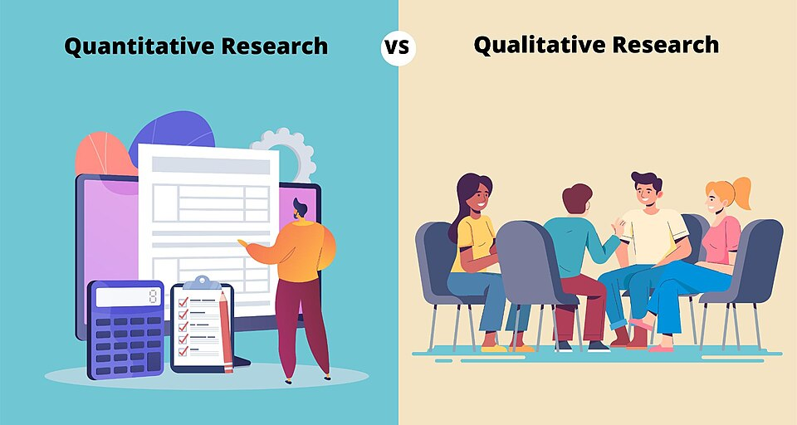
DIFFERENT KINDS OF RESEARCH
Notes:
If we think about research, the first distinction we tend to make is between quantitative research and qualitative research. Quantitative research basically means we are measuring something that can be quantified, with numbers, whereas in qualitative research we are using non-numerical methods to understand human experiences and behaviour. In qualitative research, for example, we might use interviews or focus groups to understand families’ experience of taking part in a family support intervention – but we are not measuring the impact of the intervention on their family in a quantifiable way.

Slide 11
DIFFERENT KINDS OF RESEARCH
Quantitative Research Design
Experimental
Pre-Experimental
Quasi-Experimental
True Experimental
Non-Experimental
Cross-Sectional / Repeated Cross-Sectional
Correlational
Observational
Notes:
We’re going to focus on our quantitative research, and we typically divide this into experimental and non-experimental. Experimental can make us think of white lab coats and test tubes, but what we really mean by this is that we are in some way controlling or manipulating the situation. In non-experimental studies we are just observing what’s there.
So, for example, in an experimental study we might give one group an intervention, and compare this to another group who don’t have the intervention – we are controlling who receives the intervention. In a non-experimental study, we might look at whether there are any patterns in a cohort between children’s circumstances and their outcomes – we are observing what’s there.
--------------
DON’T SAY THIS BIT
Pre-experimental: observing dependent variable after treatment of independent variable presumed to cause change in dependent variables – e.g. one-group pretest posttest​
True-experimental: randomly selected subjects and a control group​
Quasi-experimental: used when looking for a causal relationship between variables but can't use random assignment. A variable is manipulated in the experimental group, but groups are not randomly assigned, ​
Cross-sectional: snapshot of data, repeated cross-sectional is multiple snapshots of different groups of participants​
Correlational: observing natural occurrences to identify associations between variables of interest - little to no attempt to control extraneous variables​
Observational: observations of behaviour In a natural or laboratory setting without any researcher manipulation

Slide 12
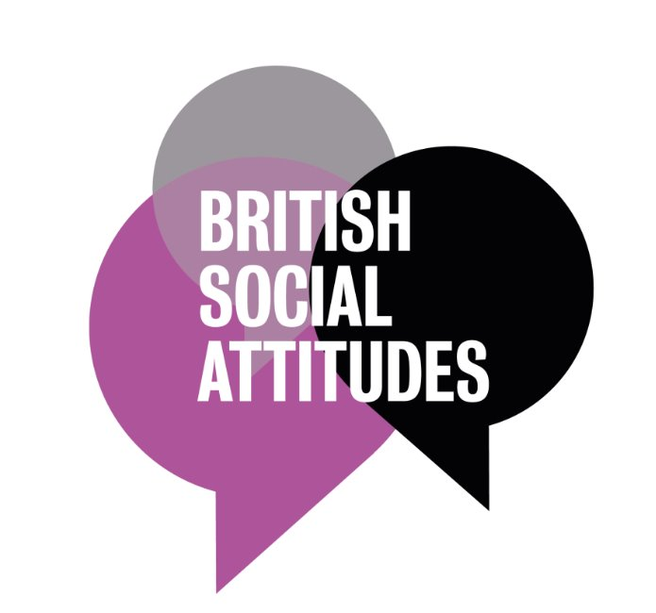

DIFFERENT KINDS OF RESEARCH
Non-Experimental
Cross-Sectional / Repeated Cross-Sectional
Correlational
Observational
Detection of new diseases
Identifying trends in a population, or co-occurring patterns
Creating theories about possible causal relationships to test
Exploration
Notes:
Non-experimental methods include things like surveys (which are a type of cross-sectional design – taking a snapshot of a group of people or a population), and cohort studies (where a group of people are followed over time).
They are really important, they can help us with:

Slide 13
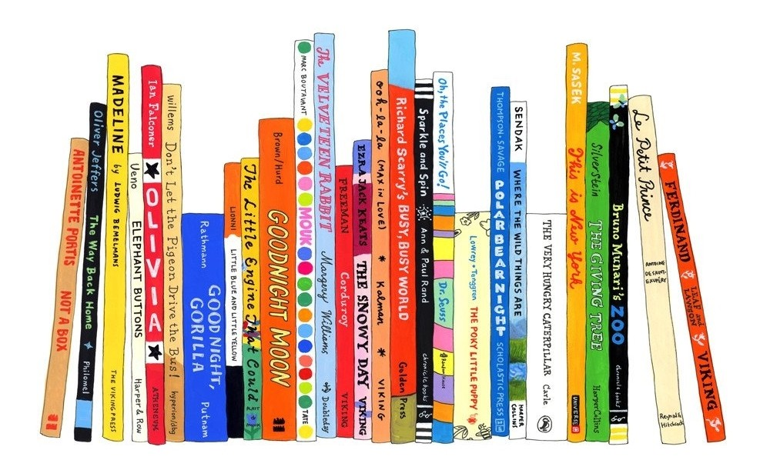
DIFFERENT KINDS OF RESEARCH
Non-experimental research cannot tell us what caused a change
Example 1: Number of books in the home and book-gifting schemes
Notes:
But there are limitations: observational and non-experimental research cannot tell us about whether one thing caused another: whether an intervention caused an improvement in children’s wellbeing for example.
Two examples:
Number of books in the home: there is strong observational evidence that the number of books in the home predicts children’s academic performance. There are good reasons to think these might be linked, for example, more books and more reading will positively affect a child’s language development, which positively affects their access to content in the classroom. This gave rise to book-gifting schemes, where families with babies or young children are given books. However, there is very mixed evidence as to whether these kinds of schemes actually have an effect on children’s outcomes. The schemes that have more of a positive effect are those that don’t just give books, but also provide training and scaffolding to parents, for example incorporating home visits. This shows that there was a missing link in our reasoning: when we observe more books in the home, this is likely because parents or carers are motivated and able to read themselves, and then share this with their children. So just increasing the number of books in the home without increasing parents’ motivation or capacities might not be very effective.
Note that I am NOT saying that all book gifting programmes are NOT effective – just that there are mixed findings, and we needed more than non-experimental research to find out. Also, there is evidence that book sharing interventions have an impact.
Summer Reading: Closing the Rich/poor Reading Achievement Gap - Google Books – does find evidence from book gifting programmes with critical appraisal
F1A694F0-C414-4DF3-9043-890BB8803817.pdf
Do Book Giveaway Programs Promote the Home Literacy Environment and Children’s Literacy-Related Behavior and Skills? - Merel de Bondt, Ingrid A. Willenberg, Adriana G. Bus, 2020 – positive findings, but no critical appraisal. Biggest effects come with programme which is not just gifting, but repeat visits and coaching

Slide 14
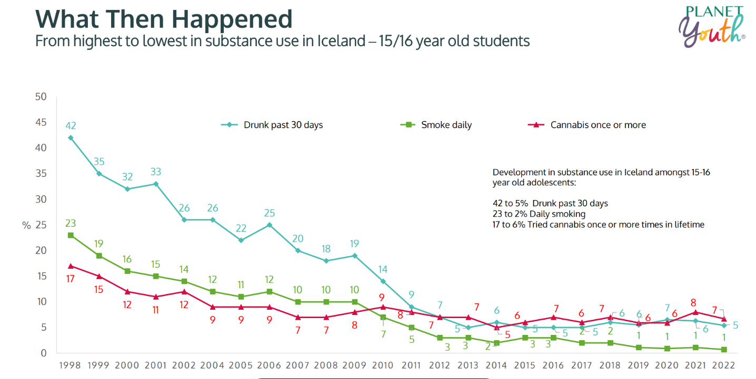
DIFFERENT KINDS OF RESEARCH
Non-experimental research cannot tell us what caused a change
Example 2: Schemes to reduce alcohol and drug use in teens
Notes:
Second example is Planet Youth, or the Icelandic Prevention Model.
Here is a graph from some of their promotional material, showing a substantial drop in episodes of drunkenness among 15 and 16 year olds from 1998 to 2022, which is claimed to be due to the introduction of this community-based system-level prevention model. It’s a striking graph and seems like a good advert.
However, all we are doing here is observing a decrease in alcohol use over time in teens – we don’t know from this data alone whether it is due to the Planet Youth model being introduced, or some other factor – some other societal change that might be going on in Iceland or internationally.

Slide 15
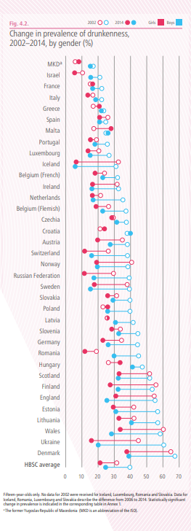
DIFFERENT KINDS OF RESEARCH
Notes:
If we look at this WHO data, this suggests that there might indeed be something else going on. Sorry it’s so tiddly – what you can see in the chart on the left, is a list of countries, with percentage of the teen population who had a monthly episode of drunkenness. Blue is boys and red is girls. The solid dot is 2014, and the circle is 2002. What you can see is for most countries, the circle (2002) is on the right, so a higher percentage, and the solid dot is on the left (a lower percentage), showing that over those years, there has been a decrease in teen drunkenness. You can see that Iceland actually started off somewhere in the bottom half, in terms of levels of drunkenness, and ended up with the lowest rates in Europe. However, the change of just over 20% decrease is similar in many other countries. This suggests that either those other countries were also introducing new programmes which are as effective as Planet Youth in reducing alcohol misuse, or that there might be a bigger trend and other social factors going on. This non-experimental data on its own can’t tell us that.
Now, it’s important to note that I am NOT saying here that Planet Youth is NOT effective; I’m just saying that we need other kinds of experiment and data to be able to tell whether Planet Youth caused the decrease.

Slide 16
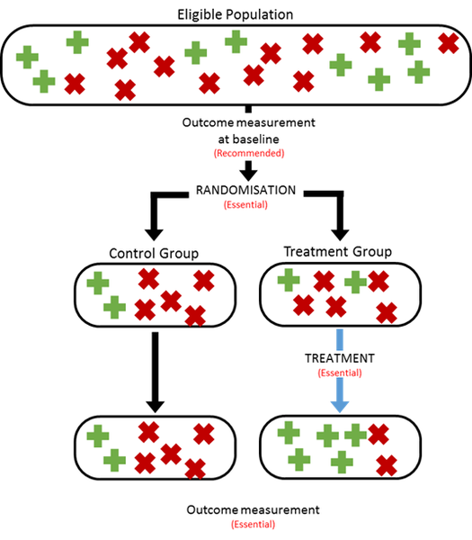
DIFFERENT KINDS OF RESEARCH
Experimental
Pre-Experimental
Quasi-Experimental
True Experimental
Randomised Controlled Trial (RCT)
Evidence that an intervention is likely to have caused a change in children or families
Notes:
Experimental studies
Remember that experimental studies involve the researchers controlling or manipulating the situation in some way. In our case, this is typically giving one group of children and families an intervention, while the other group do not receive the intervention.
If children and families are put into these groups randomly, then we call this a randomized controlled trial or RCT. These are often thought to represent the gold standard in experimental research.
Importantly, RCTs, and some quasi-experimental designs (that just means sort of experimental) can give us evidence that an intervention is likely to have caused a change in children and families.

Slide 17
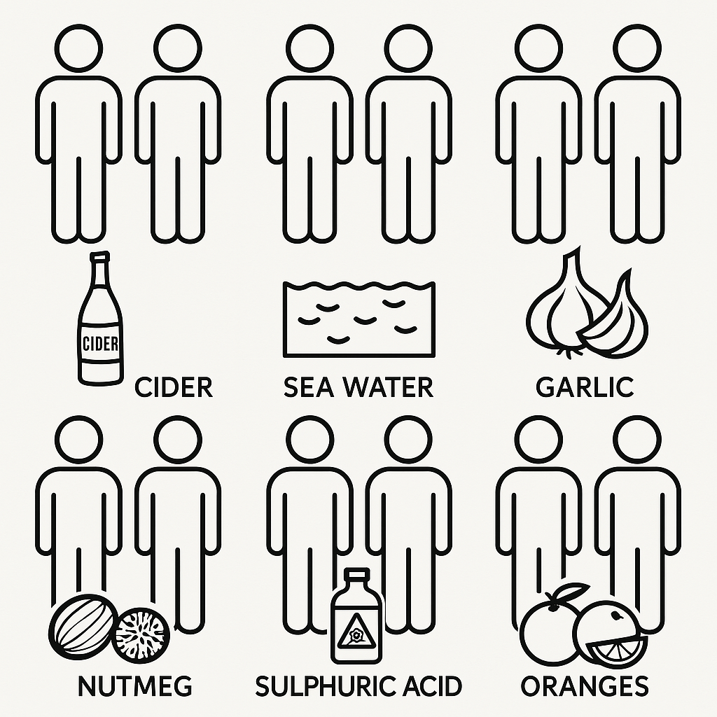
DIFFERENT KINDS OF RESEARCH
The first RCT
Notes:
Here is a fun aside: The first Randomised Controlled Trial was conducted in 1747 by Scottish royal naval physician James Lind for the treatment of scurvy.
In 1740, 1400 out of 1900 sailors died during a royal circumnavigation of the globe. Lind hypothesised that scurvy occurred due to a lack of citrus in the sailors’ diet. His assumption was based on observational evidence linking a lack of citrus fruits in the diet to an increased likelihood of scurvy. Scientists did not know about the role vitamin C played in preventing scurvy at the time.
He tested his hypothesis by randomly giving 12 sailors with scurvy on the HMS Salisbury 1 of 6 treatments traditionally offered as a cure to scurvy:
Trial lasted six days until the ship ran out of fruit.
1 sailor who was given oranges was fit to return for duty and the other was nearly recovered.
Scientific community was unconvinced — still preferred their nutmeg.
Citrus was not routinely added to sailors’ diet until 1794, when Rear Admiral Alan Gardner insisted that it be provided daily on a 3-week voyage to India.
An evidence champion was needed to have findings adopted into the community!

Slide 18


DIFFERENT KINDS OF RESEARCH
EIF Level 4
EIF Level 3
EIF Level 2
EIF NL2
Notes:
Back to the different kinds of research - remember that I said an intervention can demonstrate if something is likely to have been caused by something else: one RCT study on its own is not enough to prove that an intervention is effective – we always need larger trials which repeat or replicate a positive finding, to give us certainty that an intervention works.
Also remember back to our pipeline for covid vaccines at the beginning – each step is really important. Just because RCTs can give us evidence that an intervention causes an improvement, that does not mean that we can jump straight to running an RCT! All the steps to develop the intervention, test its feasibility, run pilot studies, and then experimental studies are really important, to help us understand how and why an intervention might work.
We find it helpful to talk about the ‘10 steps’ needed for evaluation.

Slide 19

DIFFERENT KINDS OF RESEARCH
Notes:
And these steps are likely to be an iterative process – it’s not just a matter of climbing up the stairs in one straightforward journey, but you might have to go up and down a few times, as the intervention is refined and tested again.

Slide 20

Q & A CHECK IN
Notes:
Half way point – any questions!
Share in chat: what’s the most useful or interesting thing you have learnt so far?

Slide 21
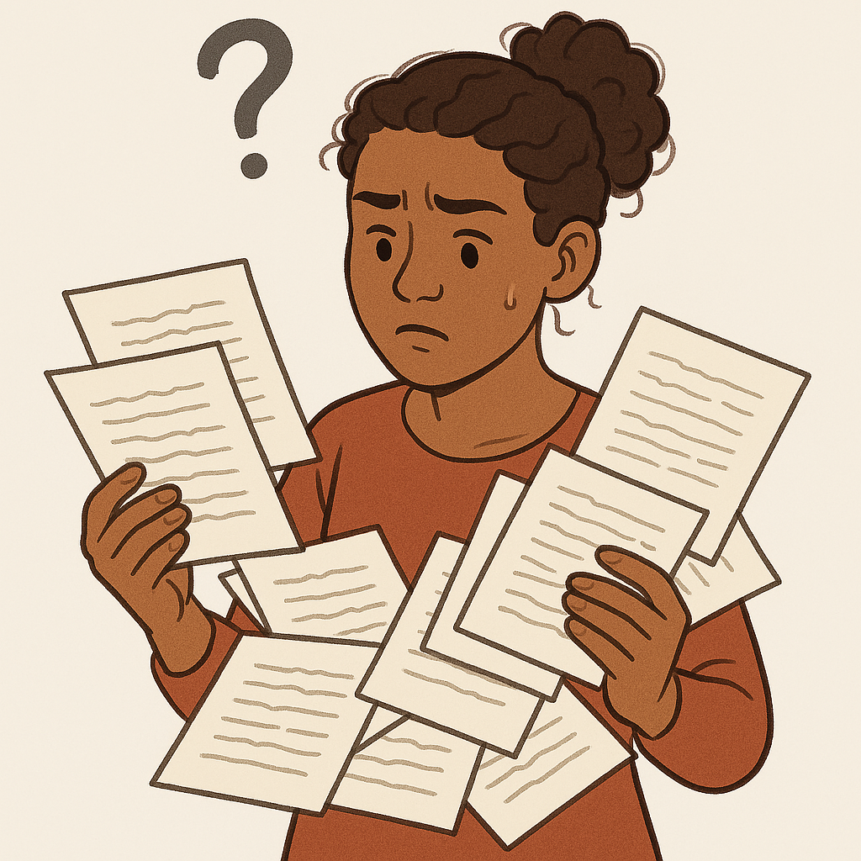
PUTTING IT ALL TOGETHER
If you wanted to find out about an effective intervention or way to support children and families, where would you look?
Notes:
Putting it all together: evidence hierarchies, evidence standards and evidence strength
So now we know that there are different kinds of research, and we need them all to work out what works: which interventions best support children and families.
But what can we do with all these different research studies? Certainly most of us don’t have the time or expertise to read them all! And then work out what their saying!
Another quick poll: if you wanted to find out about an effective intervention or way to support children and families, where would you look?

Slide 22
PUTTING IT ALL TOGETHER
Evidence hierarchies
Evidence standards
Strength of evidence ratings
Notes:
This is where evidence hierarchies, evidence standards and strength of evidence ratings come in.

Slide 23
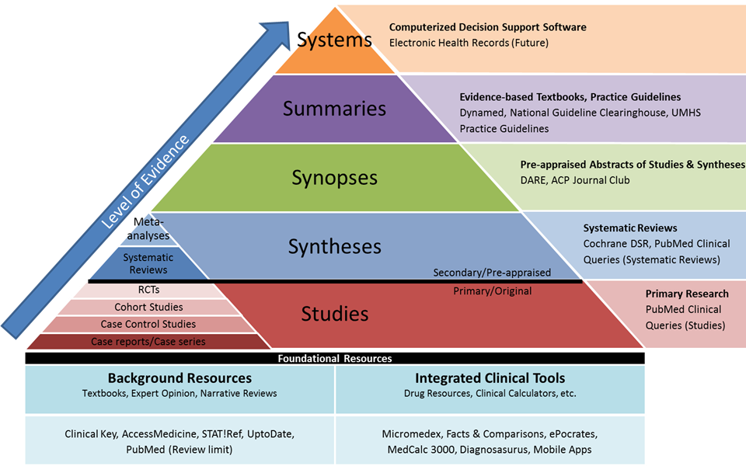
PUTTING IT ALL TOGETHER: EVIDENCE HEIRARCHIES
Notes:
Experimental evidence is considered stronger if it is repeated in a wide variety of populations and ‘real world’ circumstances. Evidence from all these individual studies can then be brought together and packaged up for users of this evidence.
Don’t worry too much about the detail of this diagram, or the examples – the key is the main pyramid, and we’ll illustrate this with some examples in a moment.
At the bottom we have our studies – this is our quantitative research that we have been talking about.
At the next level, these studies are synthesized – that’s a fancy way of saying brought together so that their findings are combined. This happens through systematic reviews.
But these are still long and tricky academic articles, so to make this synthesis more useable, we need to move up to synopses and to summaries, where the findings of systematic reviews are condensed in a hopefully accessible way that’s useful to practitioners. At the top, in some fields, these can then be implemented in systems, such as computerized decision support software in medical or clinical settings.

Slide 24
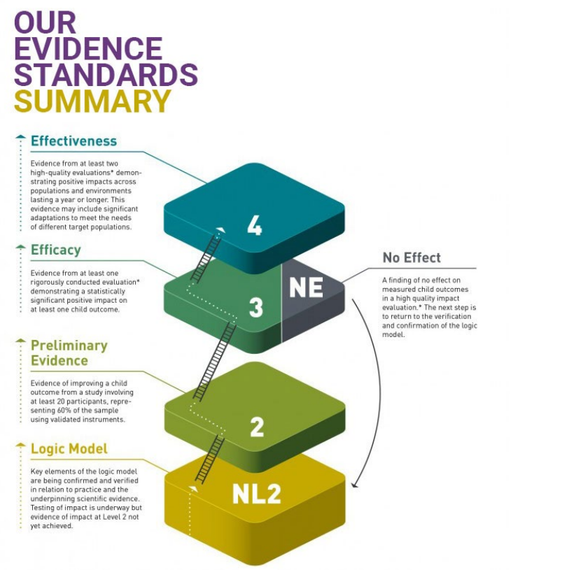
PUTTING IT ALL TOGETHER: EVIDENCE STANDARDS AND RATINGS
Notes:
It’s no good just bringing all this evidence together, if it’s not actually good evidence – that’s why Clearinghouses like the Evidence Hub, and Foundations’ Guidebook, assess how good studies are. These cover a whole range of features concerning how the trial was designed and carried out, to make sure that any findings are a result of the intervention, not a result of some other factor (we call this bias and confounding).
We can use these evidence standards to give trials a strength of evidence rating. On the Evidence Hub, a rating of Level 3 means that there is promising evidence that the intervention caused improvements in outcomes for children.

Slide 25

PUTTING IT ALL TOGETHER: EXAMPLE - INCREDIBLE YEARS SCHOOL AGE BASIC
10 mins
If your name begins with A-I: explore the Foundations’ Practice Guide on parenting through adversity, and then look at p26 of the full Guide to find out how evidence about IY supports the recommendations
If your name begins with J-P: find Incredible Years School Age Basic on the Evidence Hub, and find out what rating it has and which evidenced outcomes
Foundations colleagues: what findings are there about children’s outcomes in this systematic review of IY? Full text Abstract
If your name begins with Q-Z: look at the abstract (summary) of this individual trial of Incredible Years, and find out what kind of trial it was, and what the positive findings were for children
Notes:
We’re going to illustrate this with an example from the Evidence Hub, and from Foundations’ own work. We’re going to do this together as a worked example. Just to note – I’m not picking IY School Age Basic because it’s the best intervention – the Evidence Hub and Foundations’ Guidebook does not endorse any particular interventions.
STUDY
Randomised controlled trial of parent groups for child antisocial behaviour targeting multiple risk factors: the SPOKES project - Scott - 2010 - Journal of Child Psychology and Psychiatry - Wiley Online Library
https://acamh.onlinelibrary.wiley.com/doi/abs/10.1111/j.1469-7610.2009.02127.x
Randomised controlled trial of parent groups for child antisocial behaviour targeting multiple risk factors: the SPOKES project
SYNTHESIS
https://acamh.onlinelibrary.wiley.com/doi/abs/10.1111/jcpp.12781
What Works Ireland Evidence Hub – WhatWorks
https://whatworks.gov.ie/hub-search/
Practice Guides – Foundations https://foundations.org.uk/toolkit/practice-guides/
full-guide-parenting-through-adversity-0-10.pdf p26 https://foundations.org.uk/wp-content/uploads/2025/02/full-guide-parenting-through-adversity-0-10.pdf

Slide 26
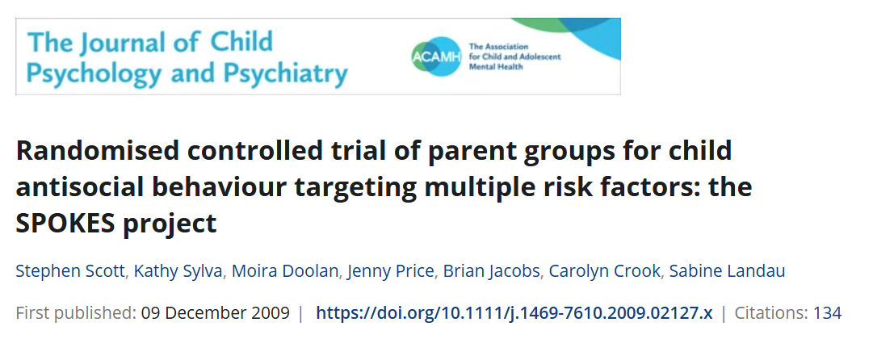
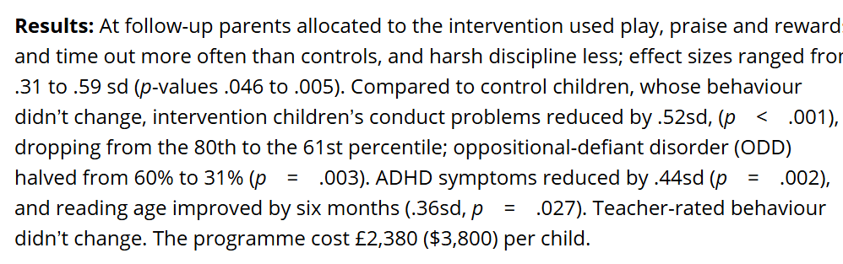



PUTTING IT ALL TOGETHER: EXAMPLE - INCREDIBLE YEARS SCHOOL AGE BASIC
What kind of trial was it, and what were the positive findings for children?
Notes:
Start with study

Slide 27
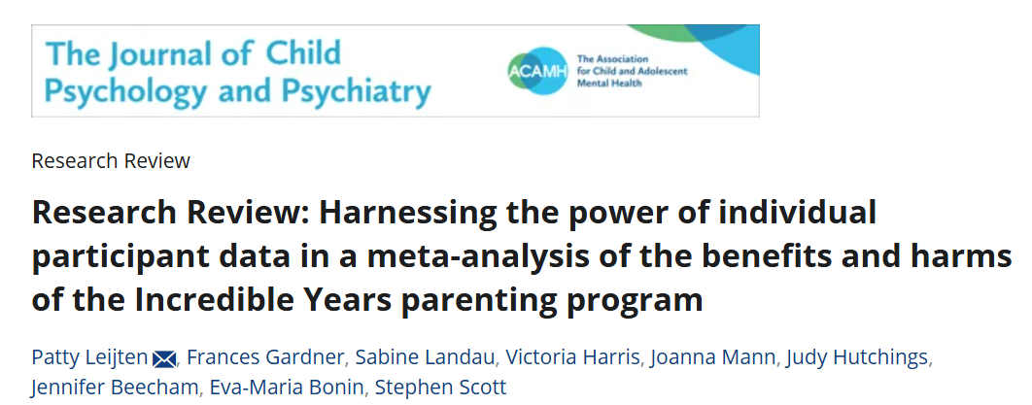
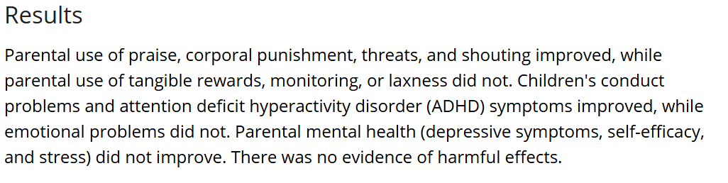


PUTTING IT ALL TOGETHER: EXAMPLE - INCREDIBLE YEARS SCHOOL AGE BASIC
What findings are there about children’s outcomes in this systematic review of IY?
Notes:
STUDY
Randomised controlled trial of parent groups for child antisocial behaviour targeting multiple risk factors: the SPOKES project - Scott - 2010 - Journal of Child Psychology and Psychiatry - Wiley Online Library
https://acamh.onlinelibrary.wiley.com/doi/abs/10.1111/j.1469-7610.2009.02127.x
Randomised controlled trial of parent groups for child antisocial behaviour targeting multiple risk factors: the SPOKES project
SYNTHESIS
https://acamh.onlinelibrary.wiley.com/doi/abs/10.1111/jcpp.12781
What Works Ireland Evidence Hub – WhatWorks
https://whatworks.gov.ie/hub-search/
Practice Guides – Foundations https://foundations.org.uk/toolkit/practice-guides/
full-guide-parenting-through-adversity-0-10.pdf p26 https://foundations.org.uk/wp-content/uploads/2025/02/full-guide-parenting-through-adversity-0-10.pdf

Slide 28
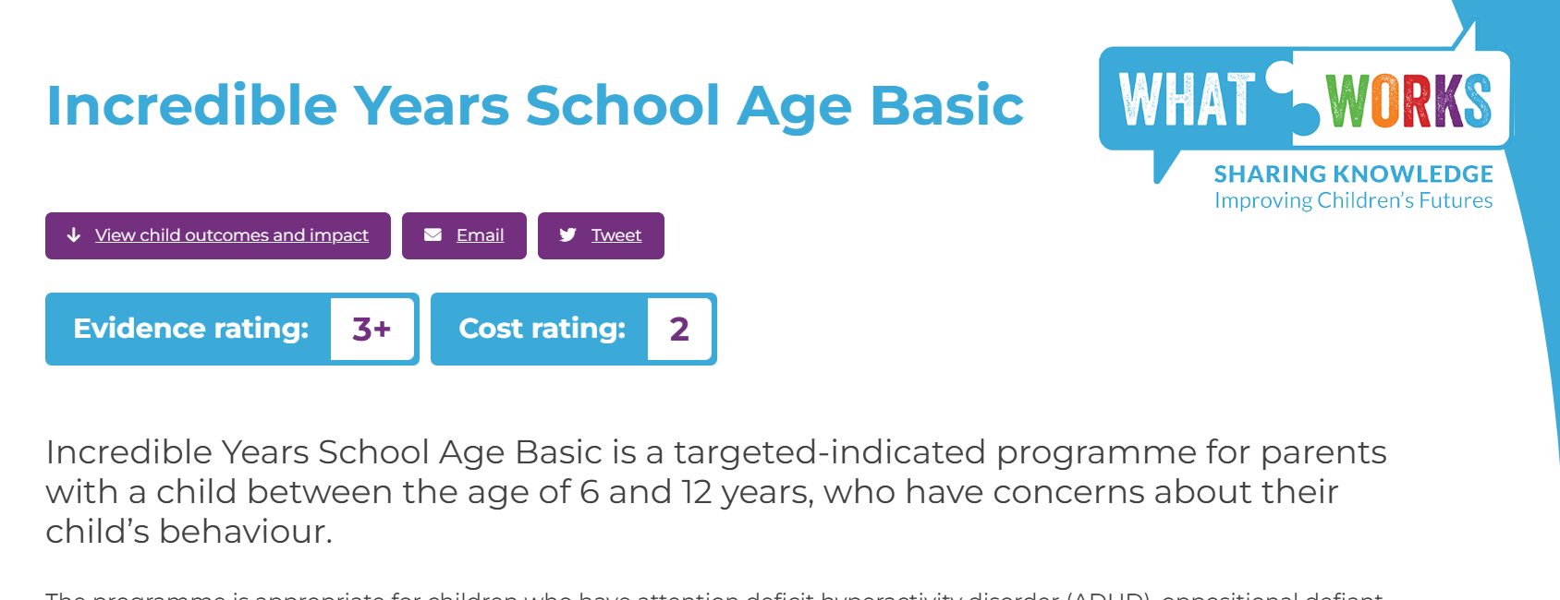
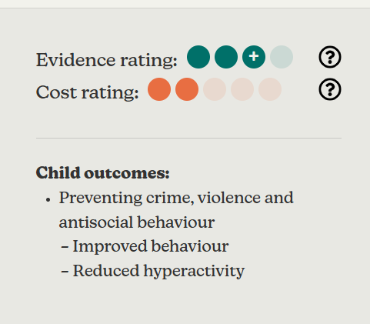
PUTTING IT ALL TOGETHER: EXAMPLE - INCREDIBLE YEARS SCHOOL AGE BASIC
What rating does it have, and what positive outcomes?
Guidebook - Foundations
Notes:
STUDY
Randomised controlled trial of parent groups for child antisocial behaviour targeting multiple risk factors: the SPOKES project - Scott - 2010 - Journal of Child Psychology and Psychiatry - Wiley Online Library
https://acamh.onlinelibrary.wiley.com/doi/abs/10.1111/j.1469-7610.2009.02127.x
Randomised controlled trial of parent groups for child antisocial behaviour targeting multiple risk factors: the SPOKES project
SYNTHESIS
https://acamh.onlinelibrary.wiley.com/doi/abs/10.1111/jcpp.12781
What Works Ireland Evidence Hub – WhatWorks
https://whatworks.gov.ie/hub-search/
Practice Guides – Foundations https://foundations.org.uk/toolkit/practice-guides/
full-guide-parenting-through-adversity-0-10.pdf p26 https://foundations.org.uk/wp-content/uploads/2025/02/full-guide-parenting-through-adversity-0-10.pdf

Slide 29
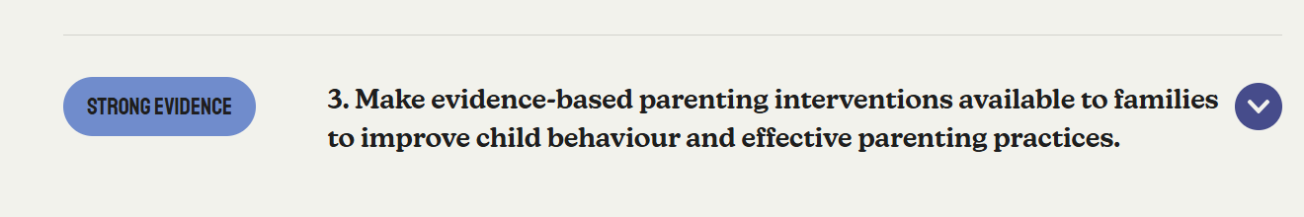
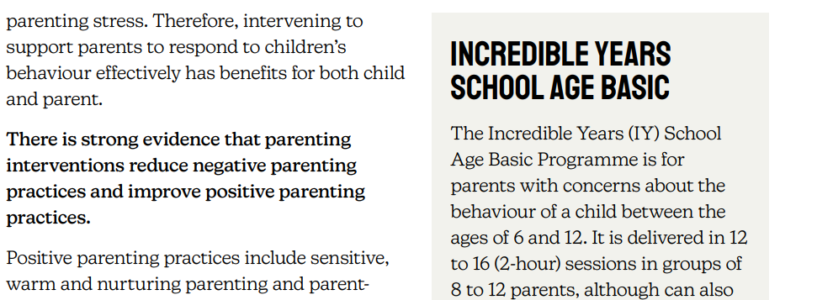


PUTTING IT ALL TOGETHER: EXAMPLE - INCREDIBLE YEARS SCHOOL AGE BASIC
How does evidence on IY support the recommendations?
Notes:
STUDY
Randomised controlled trial of parent groups for child antisocial behaviour targeting multiple risk factors: the SPOKES project - Scott - 2010 - Journal of Child Psychology and Psychiatry - Wiley Online Library
https://acamh.onlinelibrary.wiley.com/doi/abs/10.1111/j.1469-7610.2009.02127.x
Randomised controlled trial of parent groups for child antisocial behaviour targeting multiple risk factors: the SPOKES project
SYNTHESIS
https://acamh.onlinelibrary.wiley.com/doi/abs/10.1111/jcpp.12781
What Works Ireland Evidence Hub – WhatWorks
https://whatworks.gov.ie/hub-search/
Practice Guides – Foundations https://foundations.org.uk/toolkit/practice-guides/
full-guide-parenting-through-adversity-0-10.pdf p26 https://foundations.org.uk/wp-content/uploads/2025/02/full-guide-parenting-through-adversity-0-10.pdf

Slide 30
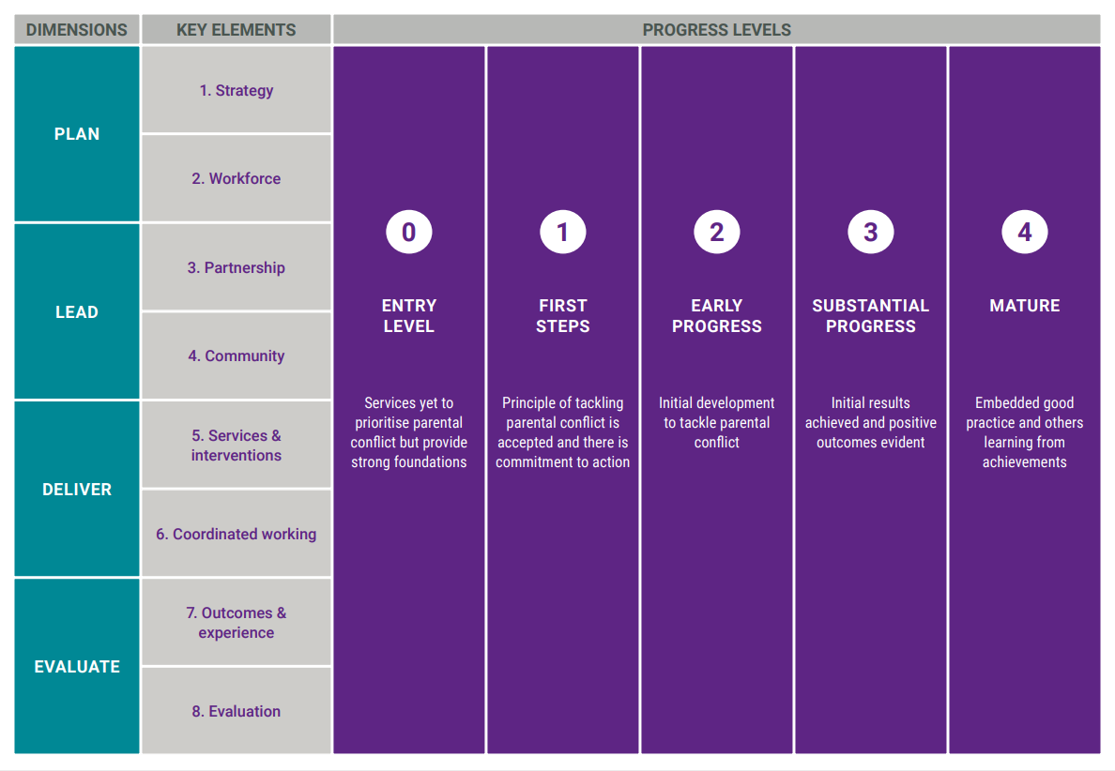
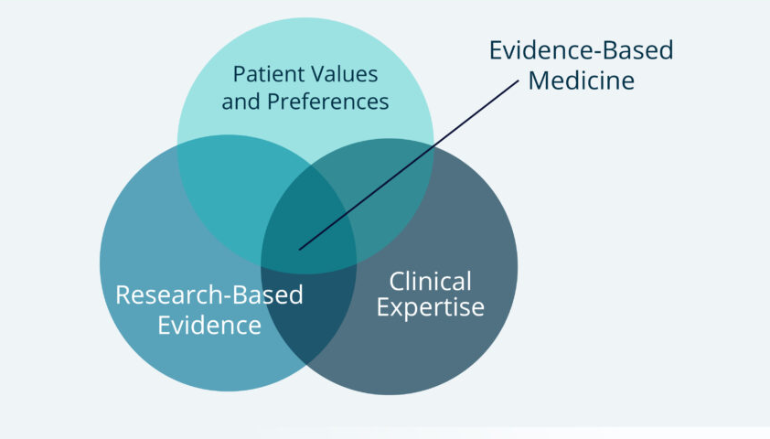
USING WHAT WORKS EVIDENCE
Reducing Parental Conflict Planning Tool - Foundations
Notes:
Just wanted to end up with a note about using What Works Evdience. Two important things to note:
What Works evidence is not the only source of evidence to be considered – within EBM, typically think of these three overlapping sources of evidence
Need to think about what will work in the local area – what is needed and what is feasible to implement given where the system is at
Commissioners who are seeking to commission a new intervention will need a good understanding of the population they serve, the outcomes which are most important to them, the budget available for the intervention, and the specific features of the system in which they are working. Commissioners may wish to refer to their population needs assessment, workforce assessment, system assessment, monitoring and evaluation data, as well as lived experiences from service users.
Graphic on right is from Foundations’ RPC Hub – planning tool

Slide 31
QUESTIONS TO THINK ABOUT
Has this webinar changed how you think about ‘research’ and ‘evidence’? How?
What do you think is the value of a ‘what works’ approach?
How could you make your practice more evidence-based?
Notes:
Time to think, write down takeaways, then share in chat.

Slide 32
Q & A DISCUSSION

